Slide 1
Opportunistic cellular network
Performance Evaluation project
Martina Criscione
Maria Taibi
Martina Troscia

Slide 2
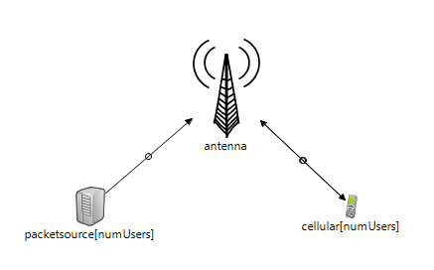
Model
The cellular network is composed by
a module antenna
a vector of modules packetSource
a vector of modules cellular

Slide 3
Tuning of factors
Number of users | 10 – 20 – 50 – 100
Interarrival means | 0.005 - 0.01 - 0.02 - 0.04 - 0.07 - 0.1
Distribution of CQI | 0 (uniform) – 1 (binomial)
Scenarios
exponential interarrivals, uniform service demands, uniform CQI;
exponential interarrivals, uniform service demands, binomial CQI;
Performance indices
throughput
global response time
used RBs
queues length

Slide 4
Objectives of the analysis
Analyze the trend of throughput, global response time, used RBs and queues length, varying the factors.
Find a trade-off among configurations to maximize the throughput and minimize the global response time.
Observe if the scenario with uniform CQIs is fairer towards users than the one with the binomial CQIs.

Slide 5
Scenario with uniform CQIs (1)
Variation of throughput and global response time increasing the number of users and the interarrival mean
With interarrival mean 0.01 and 0.02 the best trade-off between the throughput and the global response time is reached

Slide 6
Scenario with uniform CQIs (2)
With 100 users and mean 0.05 the system is near to the saturation
the percentage of used RBs is almost 100%
the queues start to fill

Slide 7
Binomial CQIs: analysis 1
The system never reaches stability
the queues of some users with low CQIs grow infinitely;
the only active users are the ones with the highest CQIs;
It wasn’t possible to perform a rigorous analysis.
What happens if a constraint is ignored and the maximum length of packets generated is decreased?

Slide 8
Binomial CQIs: analysis 2 (1)
The maximum packet length was reduced to 20 bytes.
The variation of the global response time is minimal around the value 0.0005.
Interarrival mean
The throughput is quite low but acceptable, considering the maximum packet size.

Slide 9
Binomial CQIs: analysis 2 (2)
The system has a low workload: the maximum utilization of the RBs is around 30% for 100 users and mean 0.02.
Queues are empty for most of the time.
The best performance is obtained with interarrival mean of 0.02:
the throughput and the utilization of RBs are maximized
the global response time is more or less constant

Slide 10
Conclusions
The scenario with uniform CQIs is fair towards users, as the mean value of the CQI is the same for all the users; the scenario with the binomial CQIs is not fair, as the mean value for different users is sensibly different.
The binomial distribution has worst performances with respect to the uniform distribution under the same conditions. The only way to let the system work is to lighten the workload.
The choice of an opportunistic policy on the antenna emphasize the inequalities that already exist among users when using CQIs distributed in a binomial way.

